Slide 1
Financial Aid Friendly

Slide 2
What is Financial Aid?
Financial aid
consists of funds provided
to students and families to help pay for postsecondary educational expenses.

Slide 3
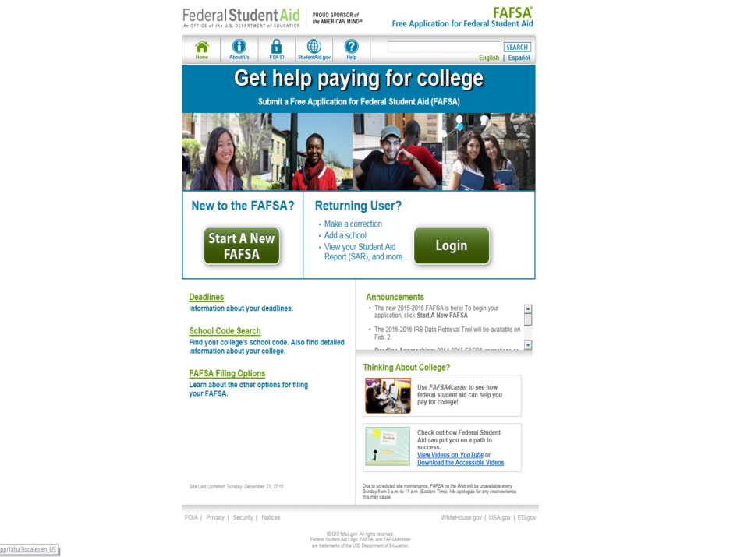
Free Application for Federal Student Aid - FAFSA
http://fafsa.gov

Slide 4
Scholarships
Money that does not have to be paid back
Awarded on the basis of merit, skill, or unique characteristic

Slide 5
Scholarships
Many scholarships and other sources of aid are awarded on the basis of demonstrated need; therefore, all students are encouraged to file the Free Application for Federal Student Aid (FAFSA) online at fafsa.gov.
Most scholarships have hard deadlines that fall around February 1st/March 1st/ April 1st.
Pay close attention to these deadlines!
Apply for as many scholarships as possible!
If you haven’t done this already – create a resume of your activities/involvement grades 9-12. Include a good solid paragraph about yourself and your future plans.
(You will thank me later when you are filling out applications for scholarships!)

Slide 6
Scholarship Sources
Outside Scholarship Opportunities
Civic and service organizations
Churches
Foundations, businesses, and charitable organizations

Slide 7
Scholarships Sources
Outside Scholarship Opportunities
Employers
Companies may have scholarships available to the children of their employees.
Companies may have educational benefits for their employees.

Slide 8
Grants
Money that does not have to be paid back
Usually awarded based on financial need

Slide 9
Grants
Federal Pell Grants - available in amounts ranging from a few hundred dollars to several thousand dollars per academic year. The amount of the grant depends on the student’s financial need, cost of attendance and enrollment status.
(1718 full Pell annual award $5920)
Federal Supplemental Educational Opportunity Grants (FSEOG) - may be awarded to students with exceptional financial need. Funds for this program are limited.
Alabama Student Assistance Program - may be awarded to students with exceptional financial need, who are legal residents of Alabama. Funds are limited.
Ask your Financial Aid Office about Grants!

Slide 10
Federal Work Study (FWS)
Based on availability of funds, when awarded FWS, students may work on or off campus and are paid at least federal minimum wage.
To be considered for this award, students should mark “Yes” on the, “Are you interested in federal work study…” FAFSA question.
Because these funds are limited, FWS is typically awarded based on financial need.
If students are not awarded (or ineligible based on need) FWS funds, but are interested in campus student worker positions, they should inquire with the campus career center and/or other designated student employment area about positions available that do not require FWS funding.

Slide 11
Loans
Undergraduate students enrolled at least half time may be eligible for the need based subsidized Direct Loan or the non-need based unsubsidized Direct Loan.
“Subsidized” means the government is paying the interest while the student is enrolled at least half time.
“Unsubsidized” means that the student has the option of paying the interest or allowing it to accrue with the principal.
For 2017-18, interest rates: sub/unsub – 4.45%; parent PLUS loans – 7%
Eligibility is based on the FAFSA information, cost of attendance and class level.

Slide 12
Federal Student Loans Limits
 | Dependent Student | Independent Student
 | Maximum Combined Subsidized and Unsubsidized Stafford Loan (Effective July 1, 2008) | Maximum Combined Subsidized and Unsubsidized Stafford Loan (Effective July 1, 2008)
1st-yr. | $5,500 | $ 9,500
2nd-yr. | $6,500 | $10,500
3rd & 4th-yr. | $7,500 | $12,500
Teacher Cert | $7,500 | $12,500
Grad/Professional | N/A | $20,500

Slide 13
Additional Outside Resources
Prepaid College Tuition Plans (PACT, etc.)
***Military Benefits (Federal; State)
***Vocational Rehabilitation
***FAFSA submission is often required to determine Pell Grant eligibility before these benefits can be applied.

Slide 14
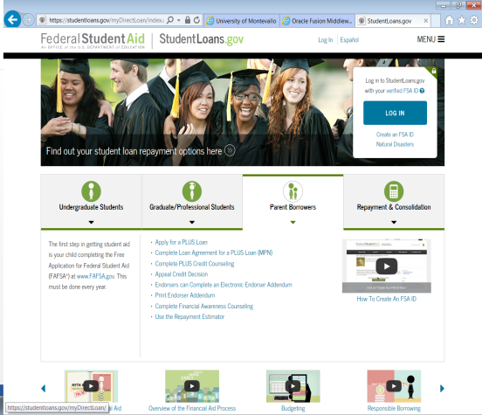
Bridging the Gap
Payment Plans
Parent Plus Loans for Dependent Students
https://studentloans.gov/myDirectLoan/index.action
(use parent FSA ID to login)
Alternative/Private Loans
SCHOLARSHIPS!!!

Slide 15
Free Application for Federal Student Aid –
FAFSA

Slide 16
FAFSA Tips
Can I choose to report 2017 instead of 2016 tax information on my 2018-19 FAFSA?
No, you do not have a choice of which year to report – use the 2016 tax information!
Talk to college if big change in financial circumstances!
Remember: Certain items on FAFSA are “as of today,” so you must read each question and fill out accordingly.

Slide 17
Free Application for Federal Student FAFSA
FSA ID
The FSA ID, which replaced the Federal Student Aid PIN in May 2015, is the username and password you use when you visit certain U.S. Department of Education websites.
Students and parents of dependent students can apply for an FSA ID at any time.
If a student does not have one by the time they fill out their FAFSA, they will be prompted to apply for one during the application process.

Slide 19
Free Application for Federal Student Aid - FAFSA
As of October 1st, you may submit your FAFSA for the upcoming aid year – it’s not too late –
but…..the time is now!
Take this opportunity to submit your financial aid application to each of your top choice schools!

Slide 20
Free Application for Federal Student Aid - FAFSA
An independent student is one of the following:
at least 24 years old
Married
a graduate or professional student
a veteran
a member of the armed forces
an orphan
a ward of the court
someone with legal dependents other than a spouse
an emancipated minor
someone who is homeless or at risk of becoming homeless
Typically, additional supporting documentations will be requested by the financial aid office.

Slide 21
Free Application for Federal Student Aid - FAFSA
Re-evaluation/Professional Judgment
If since filing the FAFSA, there has been a change in circumstances which has affected the ability to pay for college, re-evaluation may available.
Typically, a completed re-evaluation form, along with appropriate supporting documentation, will be required. (Verification, requiring a completed 2018-19 Verification Worksheet, a 2016 Tax Return Transcript, and W-2 forms must be processed prior to re-evaluation. Tax Return Transcripts may be accessed online at www.irs.gov or call 1-800-908-9946. )
The financial aid director will use professional judgment while reviewing the student financial aid re-evaluation/verification materials in order to appropriately award the student.

Slide 22
Free Application for Federal Student Aid - FAFSA
What information do I need in order to file my FAFSA?

Slide 23
Free Application for Federal Student Aid - FAFSA
2016 Income Tax Returns - students’ and parents’ 1040 forms, W-2 forms, and other records of income
Identification Documents - Social Security card, etc.

Slide 24
Free Application for Federal Student Aid - FAFSA
In case of divorce or separation, which parent’s income do I use on my FAFSA?

Slide 25
Free Application for Federal Student Aid - FAFSA
Provide household/income information of the parent in which you lived with the most in the last 12 months.
If you do not live with one parent more than the other, provide household/income information of the parent that provided you with the most financial support in during the last 12 months or the most recent year support was received.

Slide 26
Free Application for Federal Student Aid - FAFSA
IRS Data Retrieval Tool
Students and parents who have completed their 2016 IRS tax return(s) may securely transfer tax information into the FAFSA by utilizing the IRS Data Retrieval Tool (DRT).
If selected for verification, successful use of this tool may alleviate the tax return transcript requirement.

Slide 27
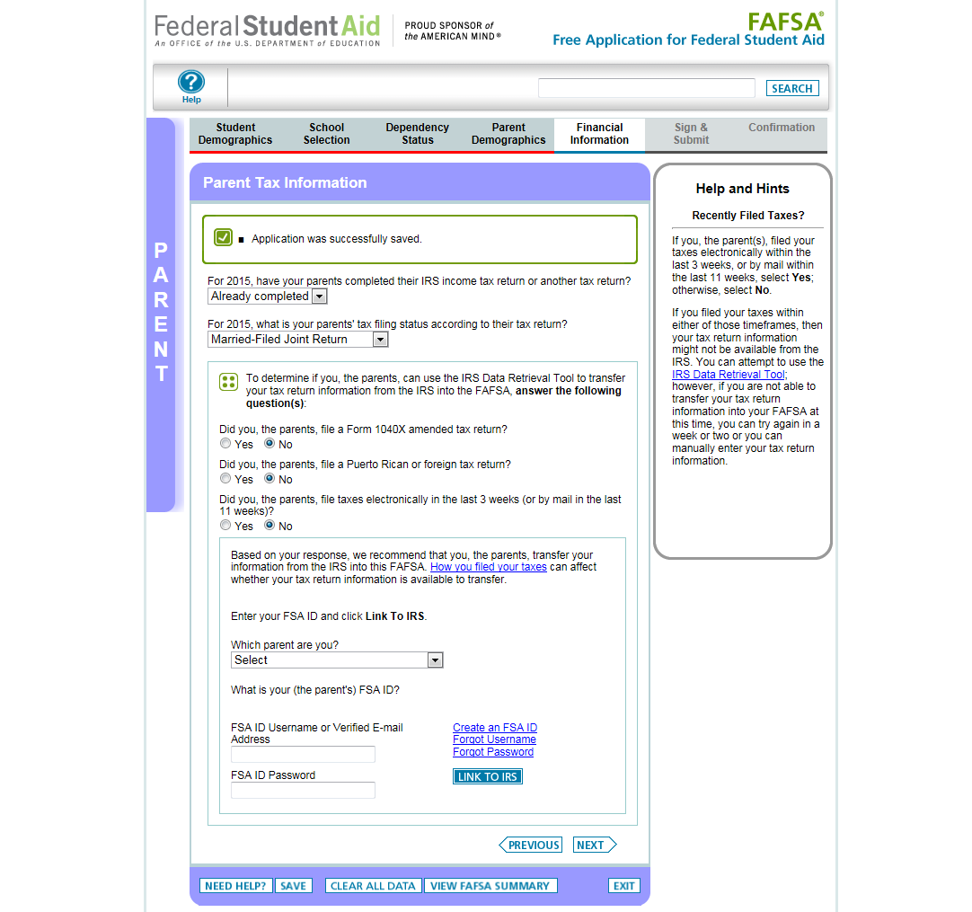

Slide 28
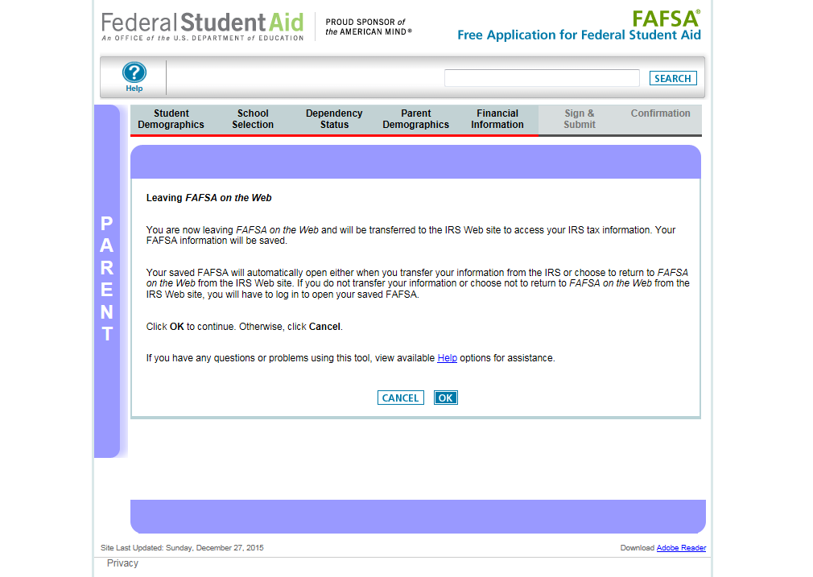

Slide 29
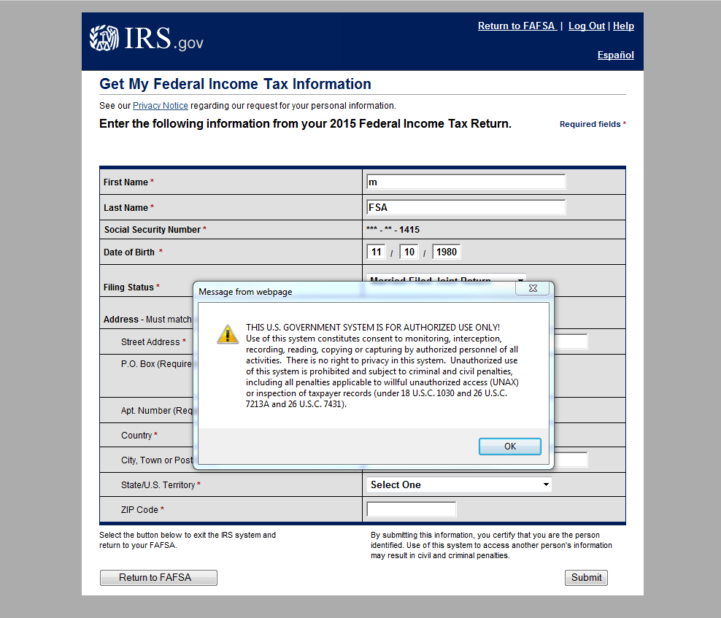

Slide 30
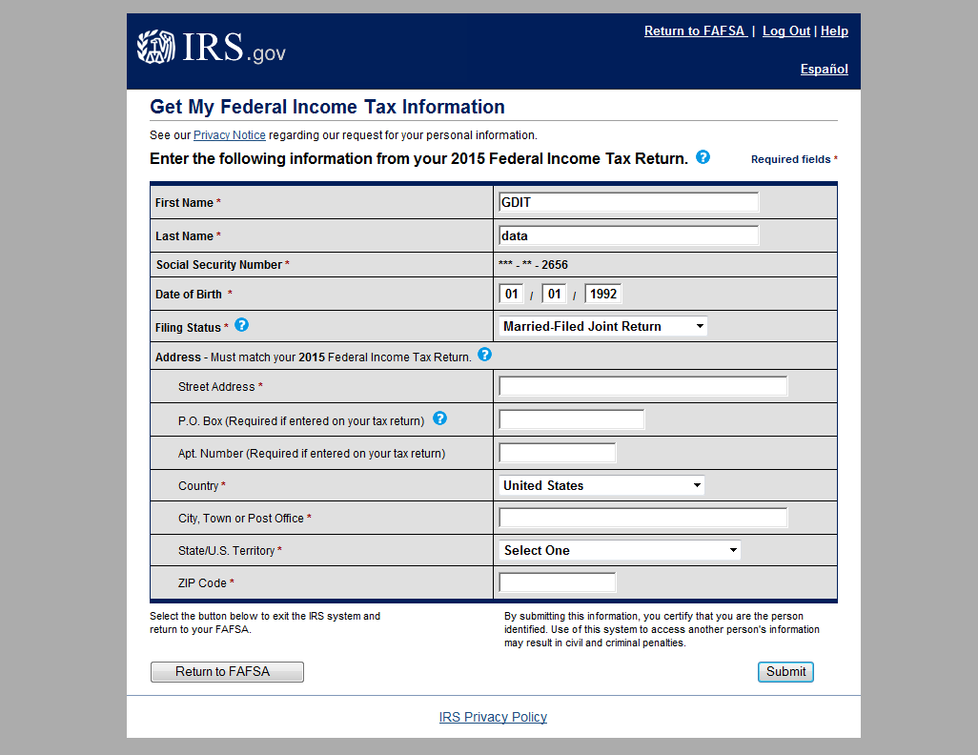
These fields are pre-filled based on FAFSA responses

Slide 31
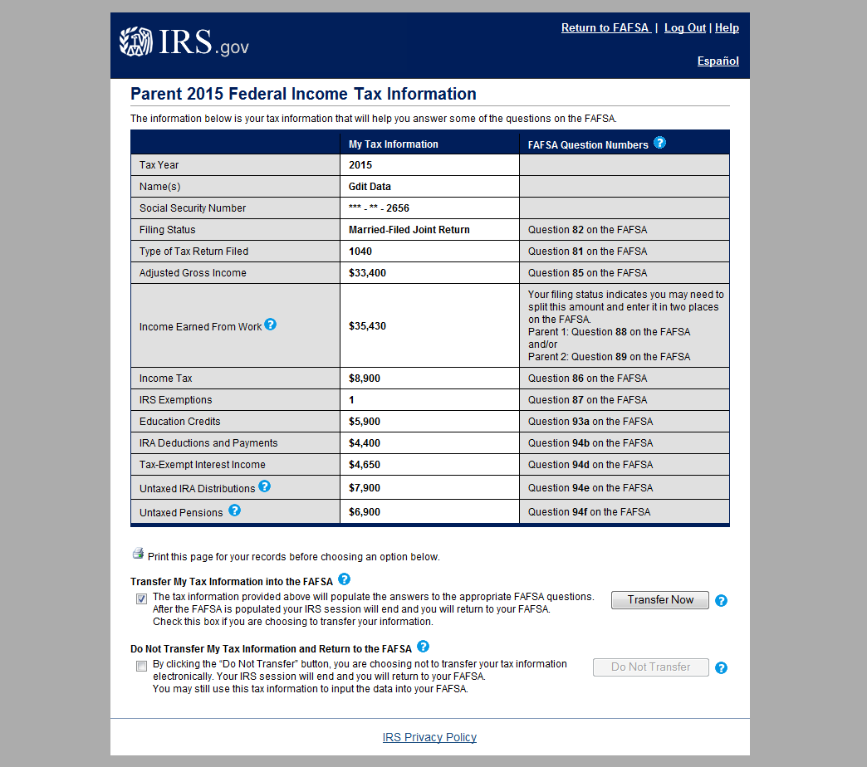

Slide 32
Financial Need Formula
Cost of Attendance (COA)
- Expected Family Contribution (EFC)
__________________________
= Financial Need

Slide 33
Verification
Verification is the process your school uses to confirm that the data reported on your FAFSA is accurate.
If you’re selected for verification, don’t assume you’re being accused of doing anything wrong.
All you need to do is provide the documentation your school asks for—and be sure to do so by the school’s deadline, or you won’t be able to get financial aid.

Slide 34
Income Tax Credits and Deductions
Education Credits help with the cost of higher education by reducing the amount of tax owed on your tax return. You may be eligible for:
American Opportunity tax credit – limited to the first four years of higher education with a variable amount not to exceed $2,500 per eligible student
Lifetime Learning credit – no limit on the number of years to claim the credit with a variable credit amount not to exceed $2,000 per eligible student
For more information, please visit www.irs.gov.

Slide 35
Income Tax Credits and Deductions
Qualified higher education expenses may be deducted on your tax return. The deduction is taken from the gross income with no need for itemization.
If eligible, a variable tuition and fees deduction may be claimed, not to exceed $4,000.
Interest paid on student loans may be deducted. If eligible, the interest deduction is taken from the gross income with no need for itemization, not to exceed $2,500.
For more information, please visit www.irs.gov.

